Slide 1
Web development
CoHo Club

Slide 2
AGENDA
Introduction to Web Development
Introduction to HTML
Structure of HTML
​Main heading (h1 element)
Paragraph (p element)
​Button (button elements)

Slide 3
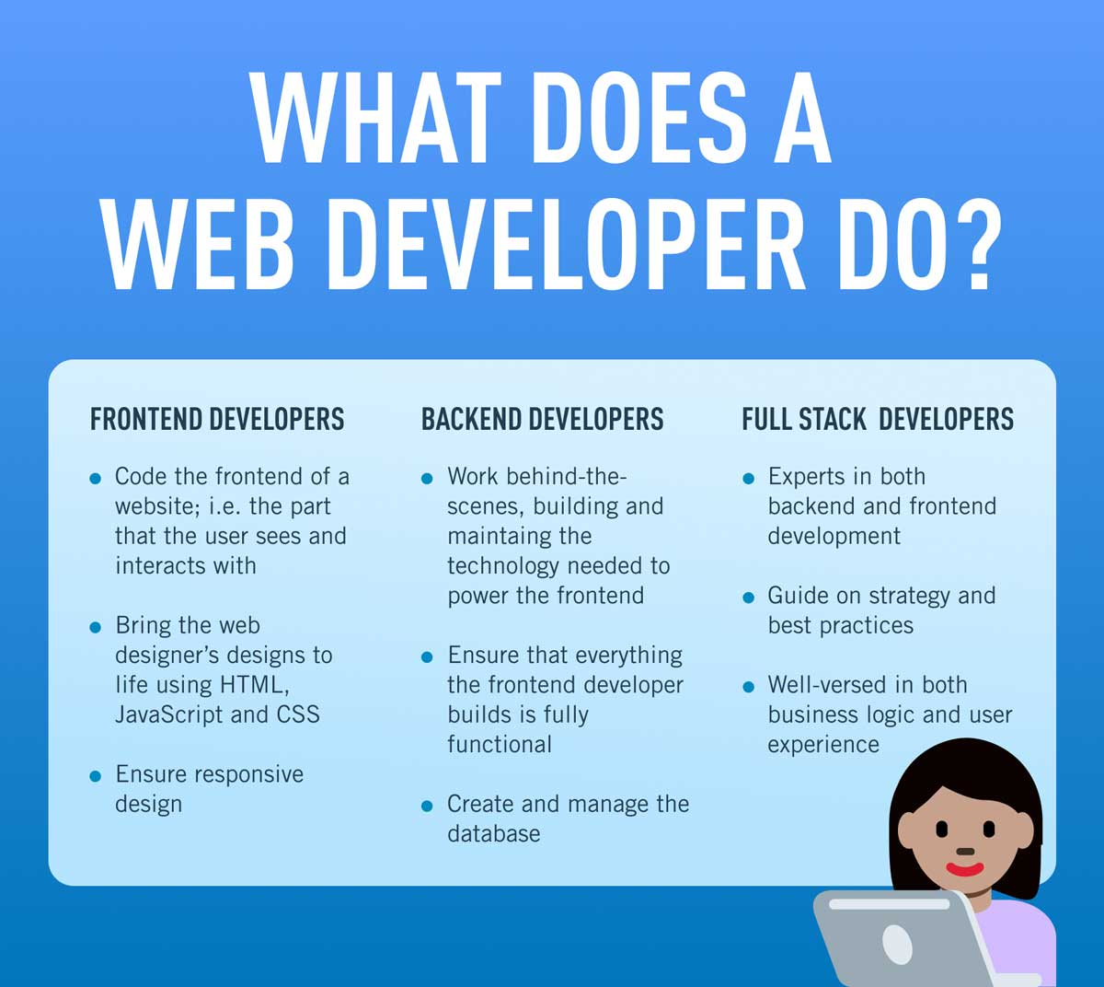

Slide 4
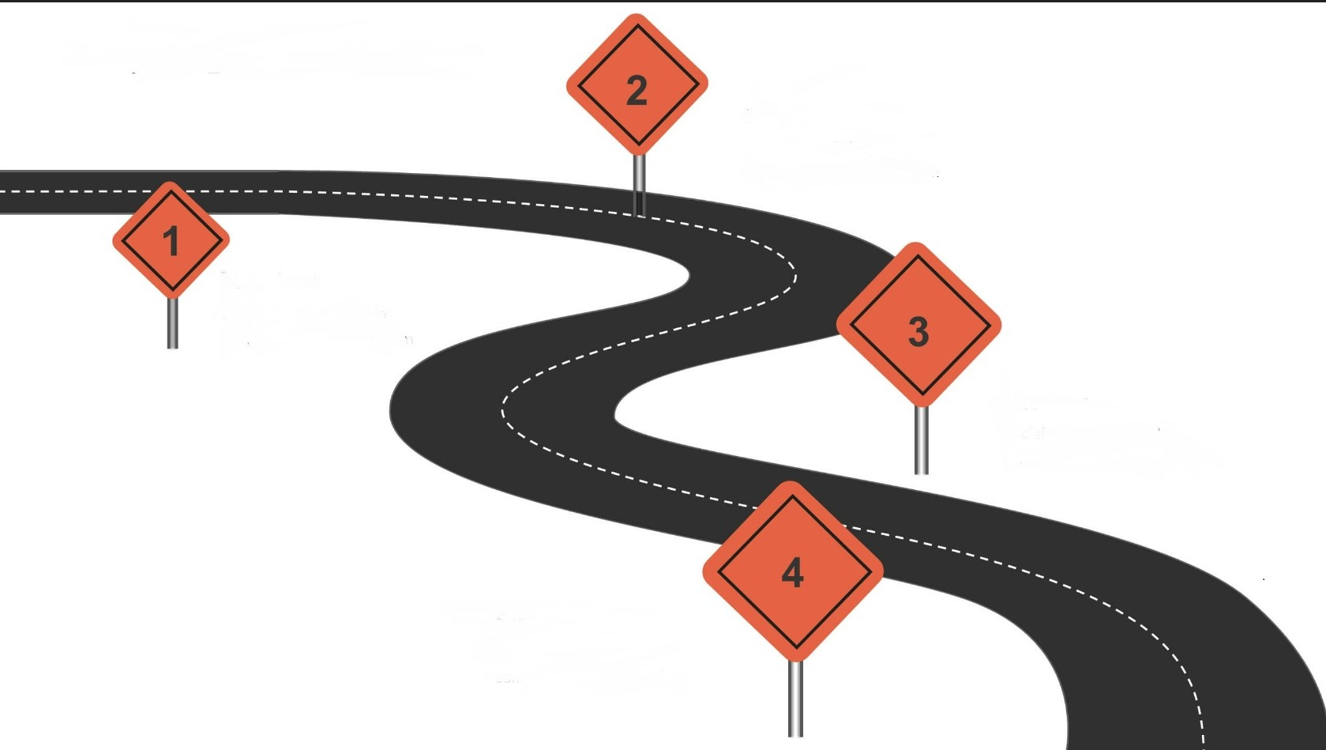
ROAD MAP TO FUTURE
BASIC FRONT END
HTML
CSS
JAVA SCRIPT
TOOLS
PACKAGE MANAGERS
BUILD TOOLS
VERSION CONTROL
What is web development
How website works
Front end and Back end
Code editor
BASIC BACK END
JAVA SCRIPT FRAMEWORK
SERVER
DATABASE

Slide 5
Introduction
HTML – [ Hyper Text Markup Language ]
HTML is the standard markup language for creating Web pages.
HTML is the building block of webpages.
HTML is the language in which most websites are written.
HTML is used to create pages and make them functional.

Slide 6
Structure of HTML
Document type
<DOCTYPE html>
<html>
<head>
<title>FIRST WEBPAGE</title>
</head>
<body>
<h1> welcome</h1>
<p>hello…..</p>
</body>
</html>
Title of webpage
Tags (which are placed inside the body).

Slide 7
HTML heading
HTML heading are defined using <h1> to <h6> .
<h1> defines the most important heading whereas <h6> defines least important heading.
Ex→ <h1> Header </h1>

Slide 8
HTML PARAGRAPH
HTML paragraph are defined using <p> .
Paragraph always starts in a new line , browser automatically adds white spaces before and after a paragraph.
Ex→ <body>
<p> Welcome to coho club </p>
</body>

Slide 9
HTML button
HTML button is defined using <button> .
The <button> tag is used to create a clickable button within HTML form on your webpage. You can put content like text or image within the <button> tag.
Ex→ <button> click here </button>

Slide 11
THANK YOU
-CoHo CREW

